Slide 1

TELECOM CUSTOMER CHURN PREDICTION
Under the esteemed guidance of A.Thanuja, M.Tech.,(Ph.D)
Team Members:-
V.Sahendra Reddy-19471A05P1
V.Ankama Rao-19471A0502
K.Chandra seakhara Rao-19471A05N0

Slide 2
CONTENTS
Abtract
Literature survey
proposed method
design
Outputs
conclusion

Slide 3
ABSTRACT
Customer churn analysis and prediction is an issue now a days because it's very important for telecommunication industries to analyze behaviors of various customer.
It is useful to predict which customers are about to leave the subscription from telecom company.
Using machine learning techniques for predicting customer churn through which we can build the classification models such as Logistic Regression, SVM, Random Forest and Gradient boosted tree.
We can compare the performance of the models.

Slide 4
EXISTING SYSTEM
The churn prediction should be correct as a result of retention ways is pricey. A limitation of current analysis is that alternative studies have focused virtually solely on churn capture, neglecting the problem of misclassification of non-churn as churn.
DISADVANTAGES:
In telecom industry if customer not satisfy with services then he will leave the subscription which may cause huge loss to Telecom Company

Slide 5
PROPOSED METHOD
In this paper, we proposed different machine learning algorithms to analyze customer churn analysis.
Through which we can multiple different models are employed to accurately predict those churn customers in the data set.
These models are Logistic Regression, Support Vector Machine, Random Forest, Gradient Boosting Trees

Slide 6
PROPOSED METHOD
ADVANTAGES:
By using this algorithms company can know about customer behaviour and based on behaviour they may improve telecom service performance.

Slide 7
DESIGN
Logistic regression: Logistic regression is a Machine Learning classification algorithm that is used to predict the probability of certain classes based on some dependent variables.(accuracy value is:81.68)
SVM: Support Vector Machine(SVM) is a supervised machine learning algorithm used for both classification and regression. (accuracy value is:82.54)

Slide 8
DESIGN
Random Forest: Random forest Logistic Regression is a commonly-used machine learning algorithm trademarked by Leo Breiman and Adele Cutler, which combines the output of multiple decision trees to reach a single result. (accuracy value is:96.16)
Gradient Boosting: Gradient boosting is a machine learning technique used in regression and classification tasks, among others. (accuracy value is:81.16)

Slide 9
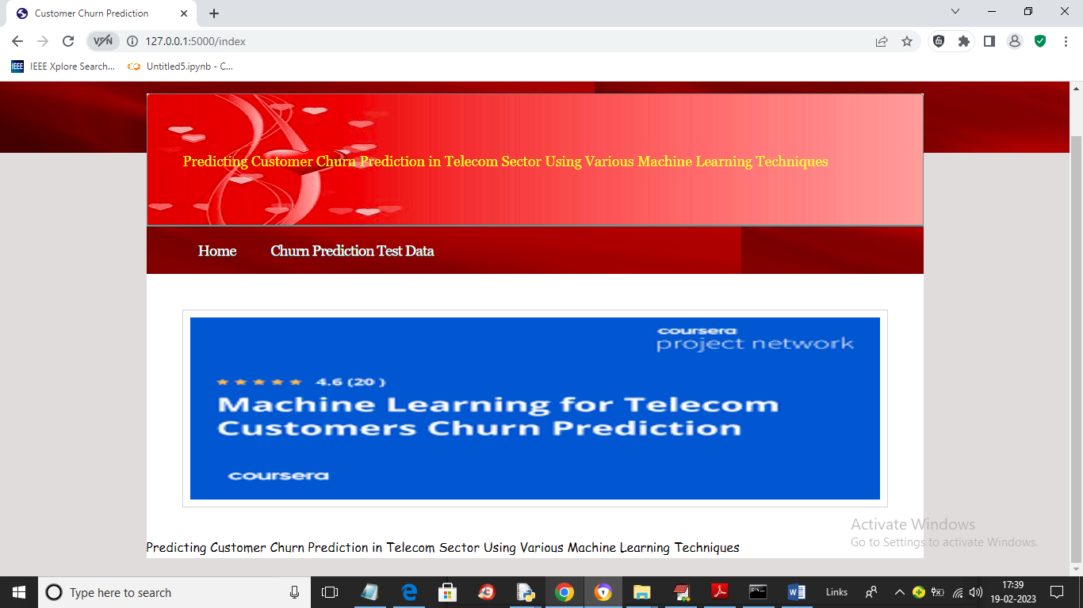
SCREEN SHOTS OF PROJECT

Slide 10
CONCLUSION
In order to retain existing customers, Telecom providers need to know the reasons of churn, which can be realized through the knowledge extracted from Telecom data. In this paper, we train four machine learning models which is Logistic Regression, SVM, Random Forest and Gradient boosted tree and we can say that Random forest is best in among four models.

Slide 11


